Slide 1
Reading Input
Converting between data types

Slide 2
Reading Information
Many meaningful computer programs require input to be read from the keyboard
Python has a function to read an entire line of input
Python, unlike other languages, only reads input line by line. Thus, for 3C, all data will be entered with one entry per line

Slide 3
Console Commands
input() is the Python function to read an entire line of input
Python can only read input one line at a time. If you are reading multiple items, be sure each item you read requires a separate line of input
Python by default interprets all input as strings. You must cast the input to convert the input from type string to int, float, or bool.

Slide 4
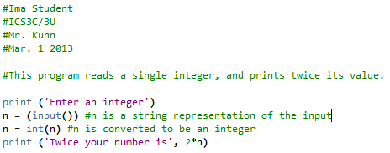

Input Example 1

Slide 5
Input Example 1 Explanation
n is not assigned a value until data is entered into the keyboard
Python does not interpret the data until the Enter key is pressed. (This is called formatted input)
n is initially interpreted as a string. We cast n to be an integer using the int() function

Slide 6
Casting
Python includes functions to re-type data using the following functions:
int(x) – make a copy of x interpreted as an integer
float(x) – make a copy of x interpreted as a float
str(x) – make a copy of x interpreted as a string
bool(x) – make a copy of x interpreted as either True or False
Note: Python will crash if an attempt to cast data from one type to another fails
E.g. The following code will cause Python to crash:
hours = ‘twenty-four’
hrs = int(hours) #Python can’t convert #‘twenty-four’ to an integer

Slide 7
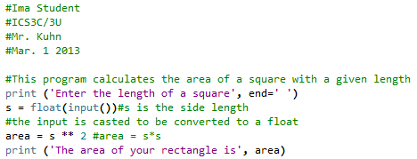

Input Example 2

Slide 8
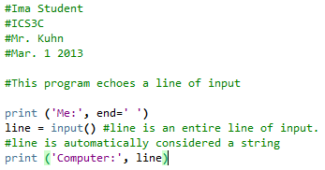

Input Example 3

Slide 9
Notes on Input
It is a good idea to store each input in its own variable.
E.g. if you enter 3 numbers, use 3 different variables and 3 separate calls of input()
Cast all input to its expected type, either int(), float, (or bool() for boolean)
Use additional variables as necessary for calculations

